Slide 1
Intro to r Codergirl summer 2019
Crystal Lewis
Missouri Prevention Center
University of Missouri, Columbia
http://prevention.missouri.edu/
hamptoncg@missouri.edu
Notes:
Research center out of the College of Education, we focus on research that promotes social and academic success for students.
Director of Data Strategy, Did CoderGirl in Summer 2018 cohort
Best practices for data management, secure data storage, data documentation, etc.

Slide 2
Schedule
Introduction to R
Review Prep Work
R
RStudio
What can R do?
Hands On
Opening RStudio
Exploratory Data Analysis
Notes:
How many people have used R before?
How many people have used other coding/statistical programs/languages? Python, SQL, SAS, SPSS, Stata

Slide 3
Review Prep Work
Installing R
Installing RStudio
Dataset downloaded to your desktop (IMDB dataset)
Questions, Comments, Concerns?
Notes:
(1) download R and RStudio

Slide 4
What is R?
R is a programming language and free software environment for statistical computing and graphics supported by the R Foundation for Statistical Computing. The R language is widely used among statisticians and data scientists for data analysis, visualization, application development and more. https://www.r-project.org/about.html
CRAN (Comprehensive R Archival Network) is where all R documentation, updates, etc. are housed
CRAN Packages
“R packages are collections of functions and data sets developed by the community. They increase the power of R by improving existing base R functionalities, or by adding new ones.” –DataCamp
There are about eight packages supplied with the R distribution and many more are available through the CRAN family of Internet sites covering a very wide range of modern statistics and functionalities.
Packages allow people to extend R capabilities and anyone can build packages.
Install and call in R (come from a library)
File Extensions you will see for R - .r, .R, .RData, .rds, .rda, and more

Slide 5
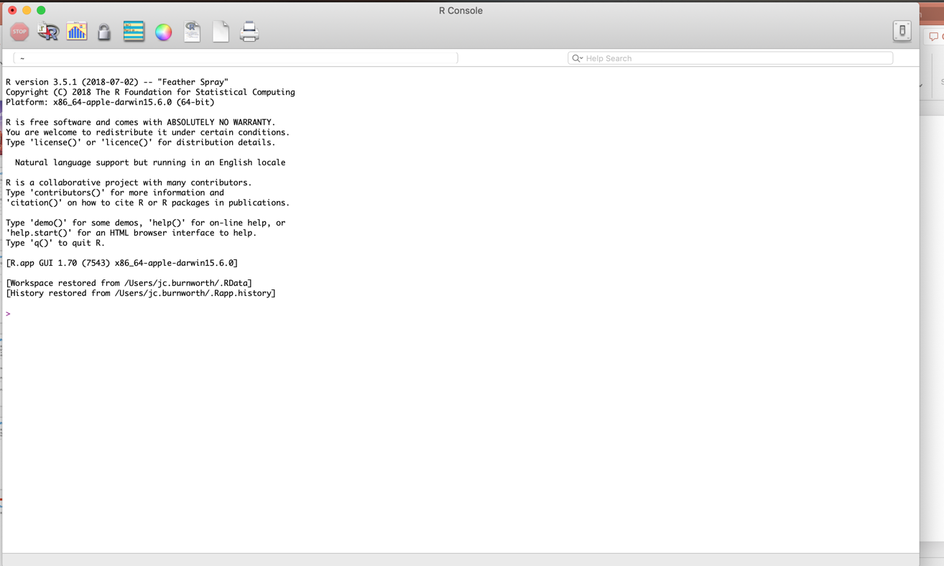
The Basics – R Console
Comes with a very basic IDE (Would not recommend)
Type & Execute Code Here

Slide 6
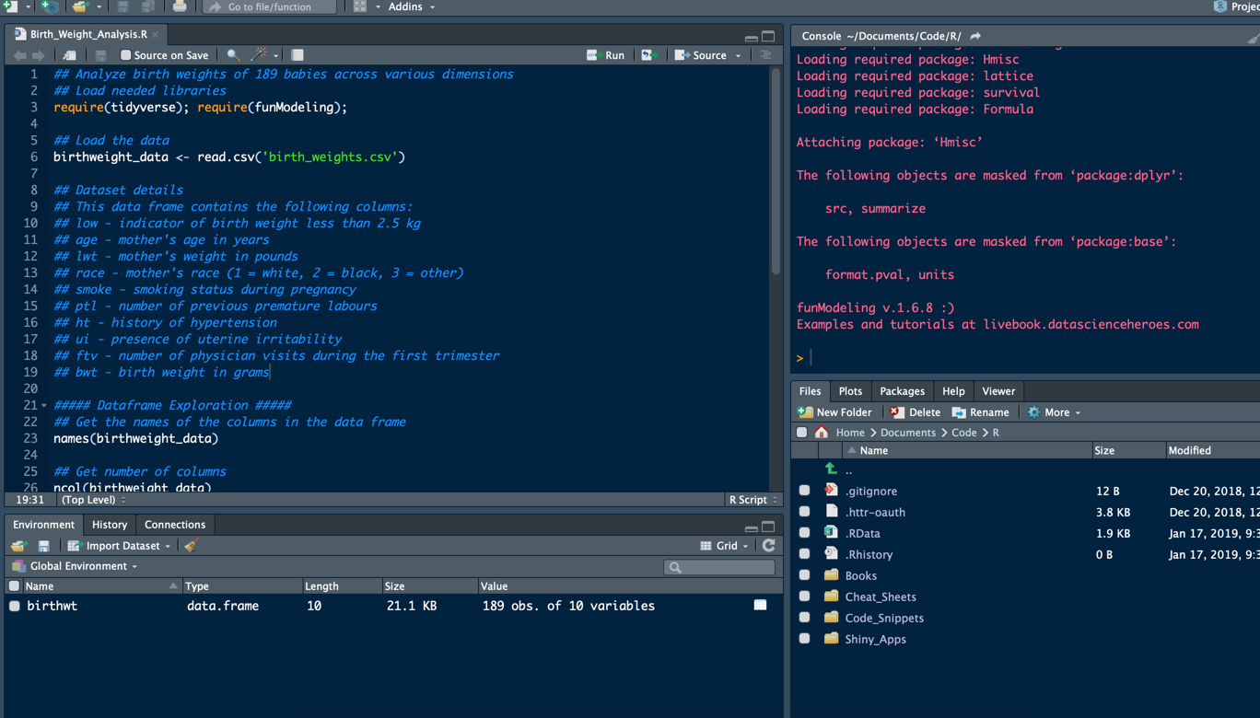
What is RStudio?
RStudio is an integrated development environment (IDE) for R. It includes a console, syntax-highlighting editor that supports direct code execution, as well as tools for plotting, history, debugging and workspace management.
Source - https://www.rstudio.com/products/rstudio/
Notes:
Makes R more user friendly

Slide 7
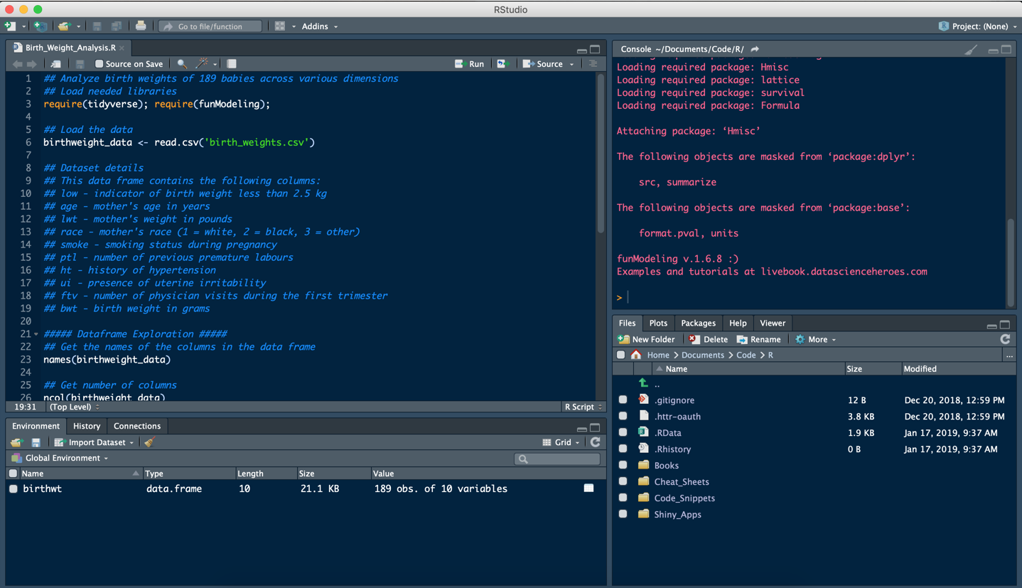
The Basics – RStudio Layout (your initial layout may differ slightly)
Console to Execute Code
Write your R code here
Viewing Area: File Explorer, Plots, Packages Available, Help Documentation
Information on data, functions, variables, etc.
Notes:
4 panes
Source window: is where you open your script and write commands/code you want to save
Console: is where you see output of your code (you can also write commands here—but won’t be saved)
Environment: shows you what you have loaded into your environment (datasets, variables, etc.)
- History shows you what commands you’ve completed so far
Viewing Area: Files, plots, etc. show you what files you have in your directory, this is also where your plots output, you can see what packages you have loaded, you can read help documents and more

Slide 8
What can r do?
Help you clean data
Rename variables, recode variables, restructure data, delete cases, etc.
Run descriptive analysis
Means, ranges, standard deviations, correlations, etc.
Run statistical analysis
Linear regression, logistic regression, even machine learning, etc.
Create graphs/tables/visualizations
Histogram, scatterplot, Bar chart, etc.
Create apps and dashboards using packages such as ShinyApps and Rmarkdown
You can connect to Git for version control
You can use Markdown or Blogdown to create websites, word/pdf/html documents, or slide decks
And More!

Slide 9
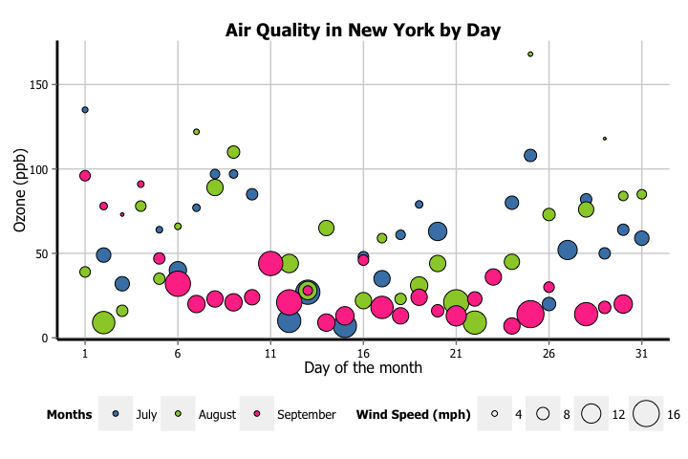
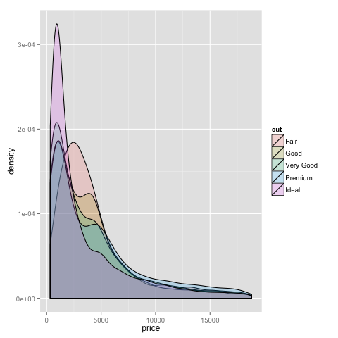
Examples of cool stuff made using r
Notes:
Scatterplot, Density Plot

Slide 10
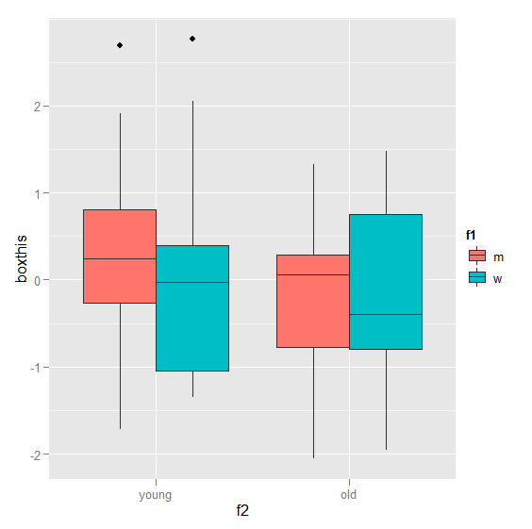
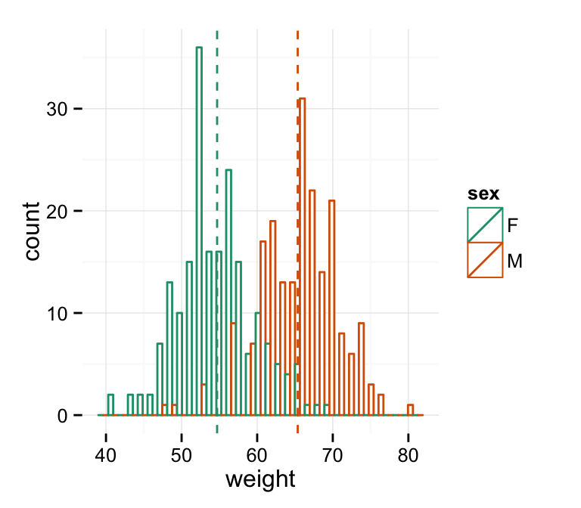
Examples of cool stuff made using r
Notes:
Histogram, box plots

Slide 11
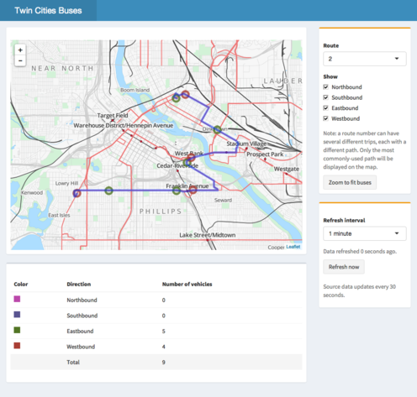
Examples of cool stuff made using r
http://shiny.rstudio.com/gallery/bus-dashboard.html
Notes:
Interactive dashboard of Twin Cities Bus Routes made using Shiny package

Slide 12
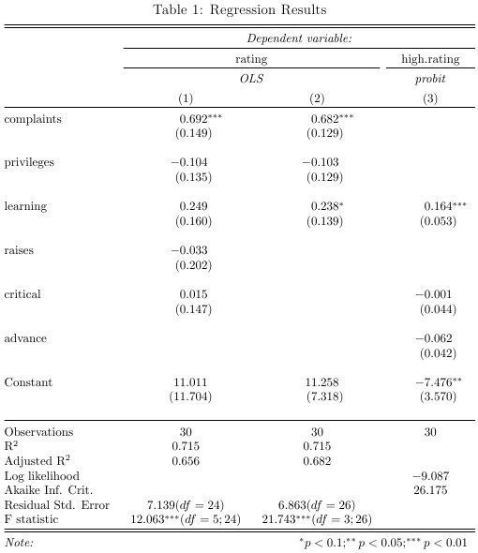
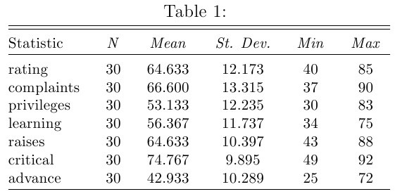
Examples of cool stuff made using r
Notes:
Table of statistics (mean, SD, Min, Max)
Table of Regression Results (coefficients, standard error, Rsquared, etc.)
Made using package called Stargazer

Slide 13
R Resources and cool stuff
https://www.r-graph-gallery.com/
https://shiny.rstudio.com/gallery/
https://www.rstudio.com/resources/cheatsheets/
https://cran.r-project.org/
Notes:
List of packages, cheat sheets, how to make cool visualizations

Slide 14
Time to get hands on!!

Slide 15
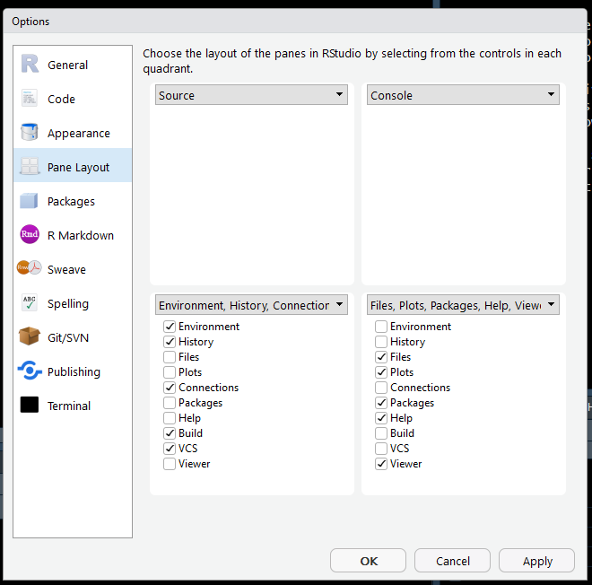
practice
Opening R Studio
Open a script
Console vs Script
Get to know the layout
Changing layout
Tools→Global Options→Pane Layout
Changing Font/Theme
Tools→Global Options→Appearance

Slide 16
practice
Type a command in the console (2+2) and hit enter
Type a command in the script (2+2) and run
Save into a variable in case I want to use that later
Adding comments (#)
You can also do Boolean Logic
Make a small data frame
c() means to combine values into a vector or list
can use : to provide a sequence of values
Save the script
Sweep Environment clean

Slide 17
practice
Changing directory
Make sure your IMDB file is saved on your desktop in a folder called “CGSum19_IntroR”
Session→Set Working Directory→Choose Directory
Installing packages
Check “Packages” to see what packages you already have installed
Always need to “library” a package each time you restart RStudio
Get help (type ?readxl or ?read_excel in console)
Open a file
Look at the file (get dimensions, structure, etc.)
Case sensitive

Slide 18
Get to know our data
Movie Metadata scraped from IMDB
From Data.World (https://data.world/data-society/imdb-5000-movie-dataset)
5000+ movies from 1916 to 2016 (100 years of movies)
Information such as:
Name of movie
Year
Director
Lead Actor
Genre
Gross revenue
Color or not color film
IMDB scores and number of votes
Content Rating

Slide 19
Answer a few questions
What is the highest gross revenue for a movie in our dataset?
What movie had the highest gross?
Dealing with duplicates
Is there a relationship between budget and imdb_score?
What country had the highest average gross revenue for movies in 2016?
aes(Aesthestic mappings—how variables in the data are mapped to visual properties of geoms)

